Slide 1
Women Safety Application
Group ID : BCA2326
Tushar Mahajan – 2020-B-12102001
Aniket Sonawane – 2020-B-09122001A
Guided By: Prof. Amit Nichat

Slide 2
Index
Introduction
Literature Survey
Purpose System
Methodology
Architecture
Future Scope
Result
Conclusion
Reference

Slide 3
Introduction
Women’s safety is a big concern which has been the most important topic till date. Women safety matters a lot whether at home, outside the home or working place. Few crimes against ladies particularly rape cases were terribly dread and fearful. Most of the women of various ages, till this day are being subjected to violence, domestic abuse, and rape. As ladies ought to travel late night generally, it’s necessary to remain alert and safe.
Although the government is taking necessary measures for their safety, still, there are free safety apps for women that can help them to stay safe. Most of the females these days carry their smartphone with them, so it is necessary to have at least one the personal safety apps installed. Such a safety app for ladies will definitely facilitate in a way or the opposite. This is user-friendly application that can be accessed by anyone who has installed it in their smart phones. Our intention is to provide you with fastest and simplest way to contact your nearest help. In this system user needs to feed five contact numbers, in case of emergency on moving the phone up and down thrice, the system sends SMS on one of the numbers feeded into the system with the location. Also Find the nearest police station. This features for both everyday safety and real emergencies, making it an ultimate tool for all.

Slide 4
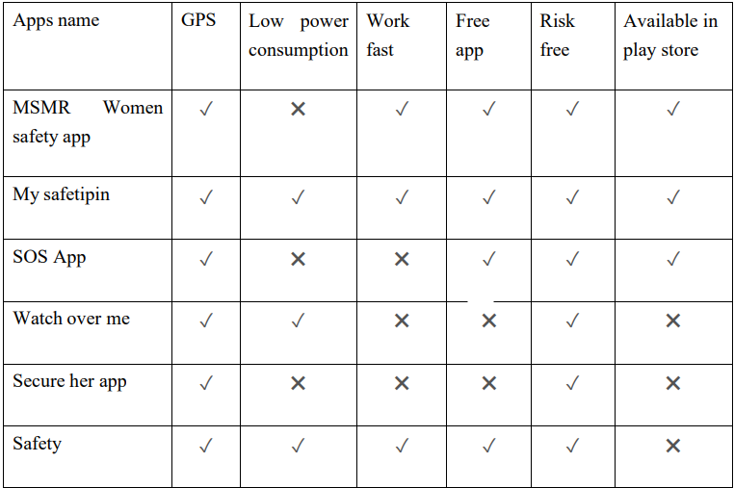
Literature Survey
As a part of literature survey, we investigated some applications of women safety that already exist in market. The aim is to observe how these applications work and to see how they can be improved and how are they different. To date it is identified that the following Android Apps of women safety are good and are offering relatively similar service. The more facility will be given to the user who will use it, so make a table and compare some apps to find out which option must be there in our apps.

Slide 5
Purpose System
The purpose of this project is to create an android application for women’s safety purpose. The application aims to highlight a safety of the women’s safety. As women’s need to travel late night sometimes, it is important to stay alert and safe. Although the gov, is taking measures for their safety, there are free safety apps for women’s that can help them to stay more safe.
The proposed system is implemented with the help of android application. In this application, Our system is designed in such a way that it will be unique from other existing apps by integrating all the features offered by those. The user needs to initialize the application by registering. Users can log in with their registered email and password.
At any emergency situation people get panicked and in that situation, they may not be able to operate their smart phone applications, and cannot immediately defend the attacker and protect themselves.
The proposed system can be useful for woman and children for security purpose. It consists of wearable safety device having sensors which when activated sends an alert message with location information to the victim’s family and selected contact’s.

Slide 6
Methodology
To develop a system for android users for keeping track through several applications. This applications uses GPS for identifying the location of the person in trouble and the system can be divided into two modules.
First module can be the victim’s phone that is the root device which uses 3G/2G data connection for tracking the location of a victim through GPS.
Second module can be the mobile phone of registered contacts either police , friends or family members which receives the message containing URL of location of victim that is send from the root device.

Slide 7
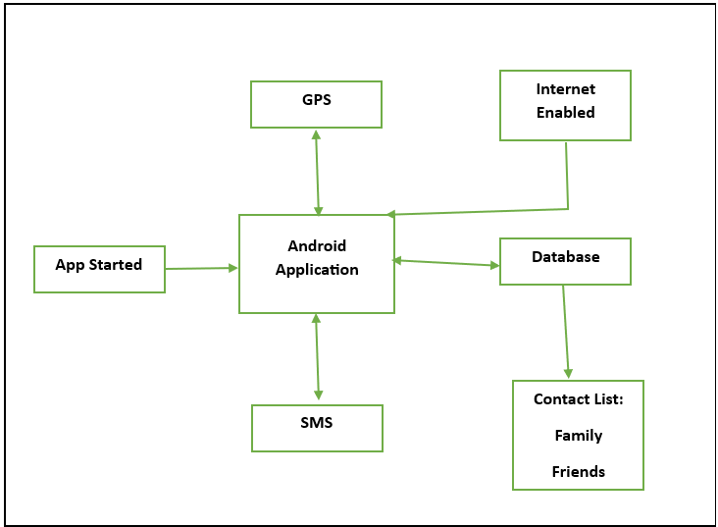
Architecutre
The proposed architecture depicted below shows the exact flow of control of the android application. Here the database acts as a storing media between the two mobile devices. The database information i.e., to which database the information has to be sent, the URL of the database is coded itself in the application. From the database, the location coordinates are sent to the registered contacts of the user. The fundamental point of this undertaking is to build up a framework that can deal with and figure out how to send message to the companions or relatives when a young lady/lady in threat for quick help.

Slide 8
Future Scope
We will continue to develop this app in future. There could be some more option in this app which can make it more batter. In future there will be more progress in our technology by using which we will be able to make it more batter. Update version will be bringing in the market for user. This project is very essential for women. In future everyone will be highly dependable on the technology, and everyone will be willingly start to like technology that time our project will be more popular among the girls and women. Already we have some plan to add some features in this app so soon in future.
Nearby friends
Nearby relatives
Keep attention of parents
Keep the camera on
And many more……

Slide 9
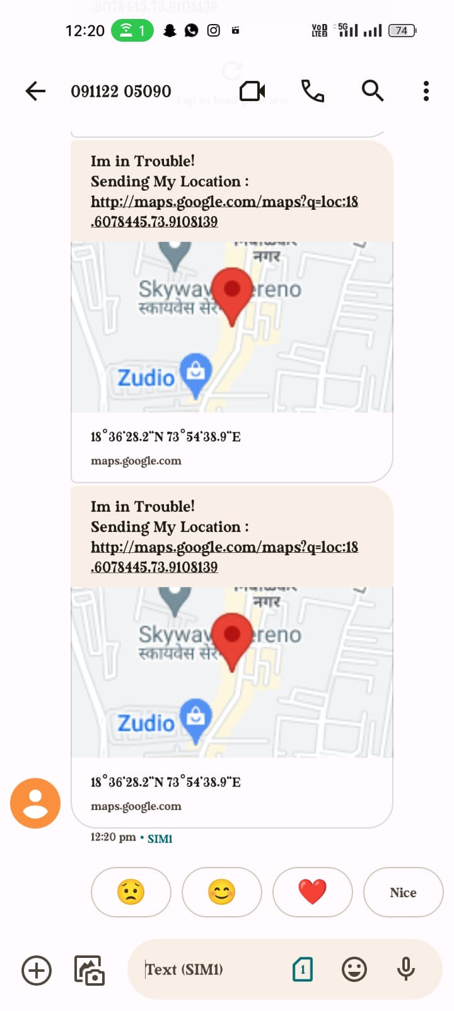
Result

Slide 10
Conclusion
To summarize, our software provides a safe and secure environment for women in society, allowing them to work late into the evening. Anyone thinking about committing a crime against a woman will be stopped, and the rate of crime against women will drop. This programme will act as a weapon for women, safeguarding their safety and security, and it will run on any Androids.
Unfortunately, the safety of women is in doubt and security is not concerned. Many headlines still coming across against women indicates that increasing trends of such sexual assault rapes still happening in today’s generation. Around 80 percent of women are losing confidence and have fear of the realization of freedom. So we are trying to contribute little efforts towards women which will ensure the safety and respect for women so that she canal so have the right to grow equally like men. This mobile application is very much helpful for anyone. This application will help the user by Adding the important mobile numbers and send GPS location through the sms by shaking the mobile phone and its also showing nearby police station by using the google map . Here the user can take precautions before coming to the actual danger. It is to let every women is now safe to travel alone as someone is getting their updated location. For the future, we have in mind to extend this app where she can also contact nearby police Station in case of need. This project that I have made is small scale but has a large development scope.

Slide 11
Reference
https://www.powershow.com/view0/8723a9YWFlM/8_Tips_For_Women_Safety_powerpoint_ppt_presentation
https://trak.in/tags/business/2014/12/22/women-safety-apps-really-useful/
https://www.ijert.org/research/women-safety-devices-and-applications-IJERTV7IS070077.pdf
https://www.researchgate.net/publication/299404936_Women_safety_device_and_application
https://papers.ssrn.com/sol3/papers.cfm?abstract_id=4121024
https://www.ijraset.com/research-
https://www.studocu.com/in/document/indian-institute-of-technology-dharwad/computer-engineering/women-safety-doc/42435894

